Slide 1
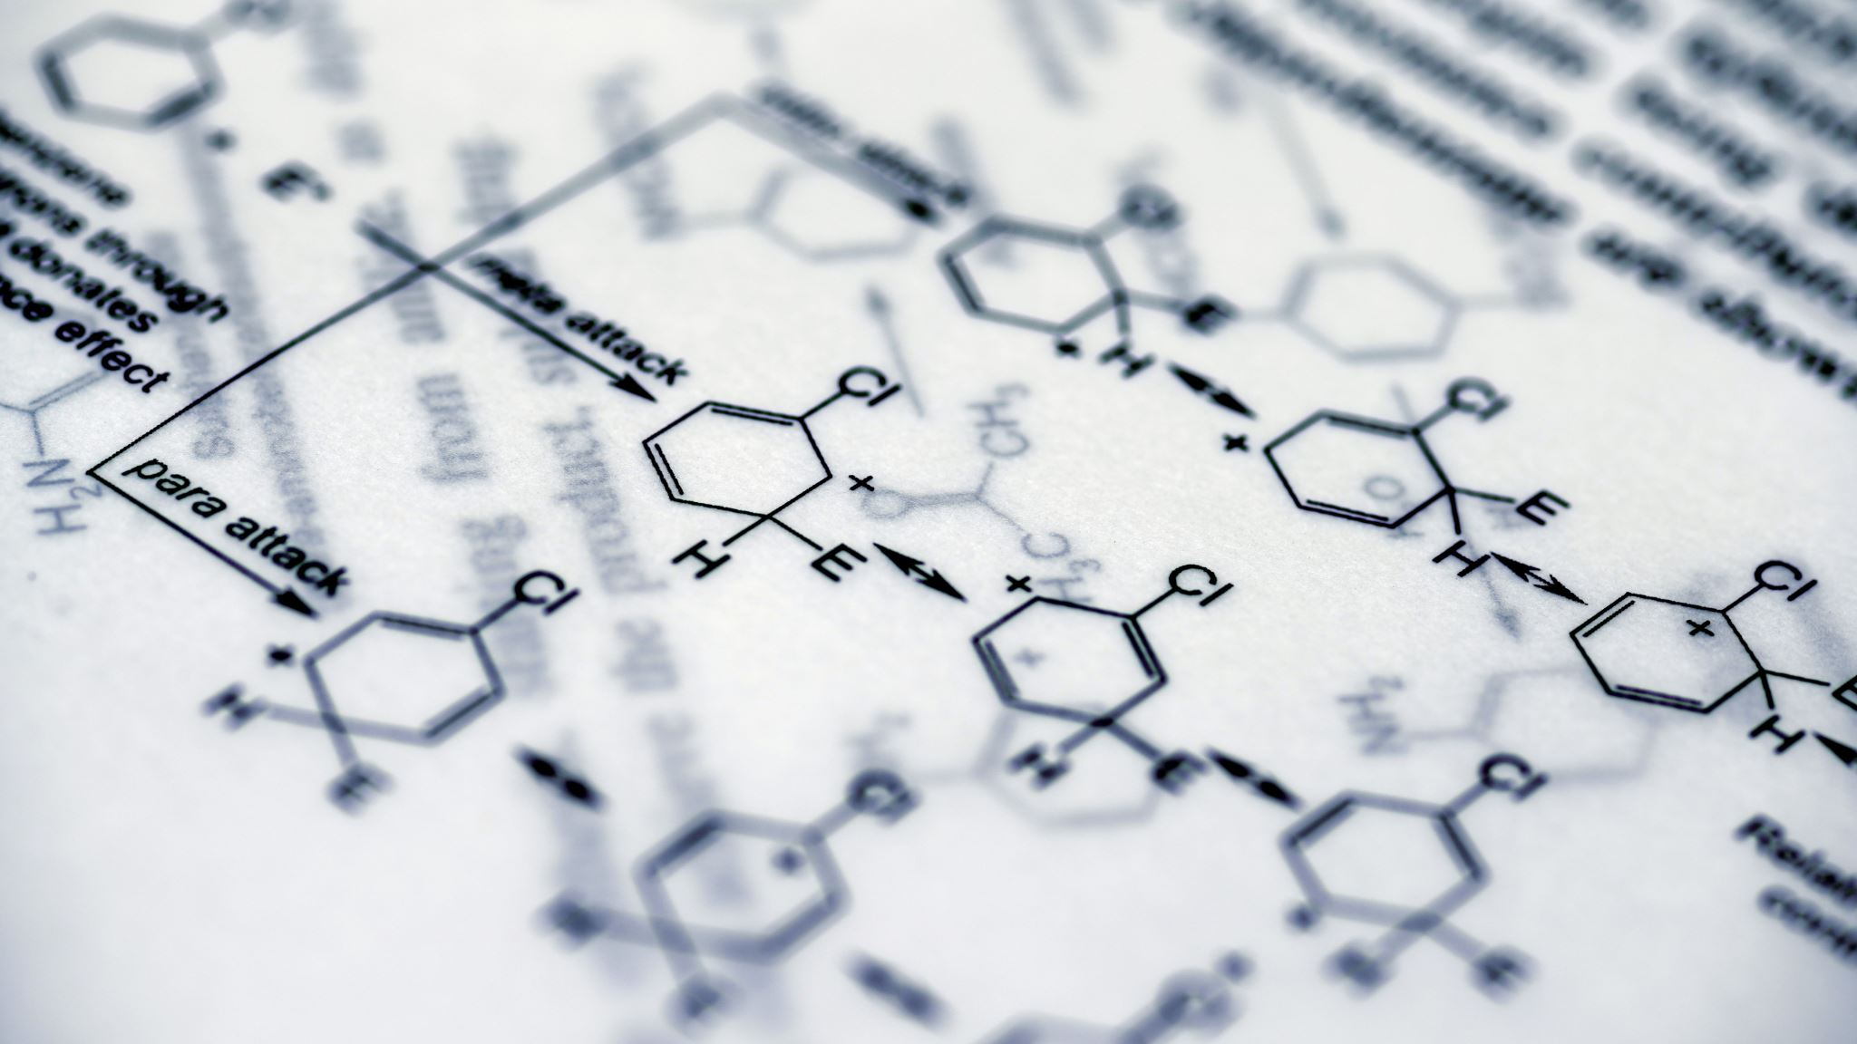
Computational design of GCase: Alternatives and screening
Jihun, Kwon (02116987)
1 / 12

Slide 2
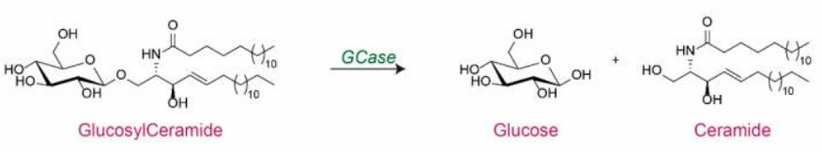
What and Why - GCase
Gaucher disease
Occurred by mutation of gene (GBA1) encoding β - glucocerebrosidase (GCase)
Lack of GCase: lipids accumulated in lysosome → Gaucher disease
Problem
Enzyme alternating GCase is still too expensive ($70K-550K/year)
Could brand-new designed enzyme can have cost efficiency??
2 / 12

Slide 3
Overview of pipeline – De novo design
Input: 2NT0 (structure of Native GCase – only if needed)
Method A: GENzyme
End to End enzyme generation model
Method B: RFdiffusion3 + GENzyme
Motif from GENzyme + Scaffold from RFdiffusion3
Method C: RFdiffusion3
De Novo synthesis of scaffold with original GCase
LigandMPNN + ESMfold
3 / 12

Slide 4



Overview of pipeline - screening
Screening the De novo synthesized result
Molecular docking
simulation
Pharmaceutical
screening
Selectivity screening
Rosetta
relaxing
Main point for comparison
Result
comparison
Does structural stability improved?
Does docking result improved?
Which sample usable as wet lab provided?
4 / 12

Slide 5
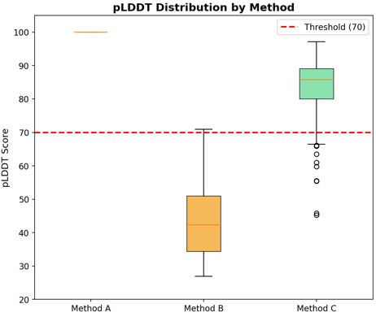
Result 1 – Does structural stability improved?
Method A: Use ESM3 for filtering structure
Method B: Relatively low pLDDT
Method C: Relatively high pLDDT
Shouldn’t method B display similar pLDDT to method C??
*pLDDT: predicted Local Distance Difference Test
5 / 12

Slide 6
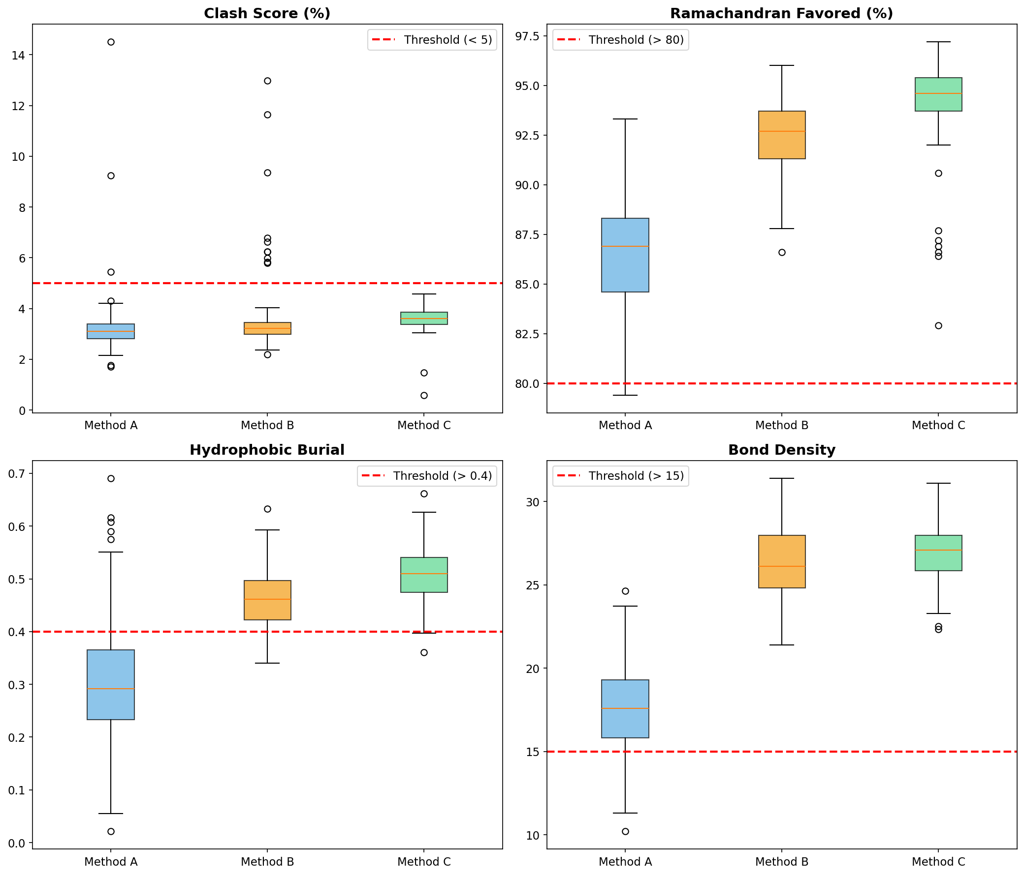
Result 1 – Does structural stability improve?
Method A: Self – consistency problem
Method B: Most of the result of analysis number -> usable structure
Method C: Relatively high pLDDT + best result in analysis number
pLDDT is not Super-tool!
Cross validation between other factors is necessary!!
Most of method A gets No-go
: Dead zone
6 / 12

Slide 7
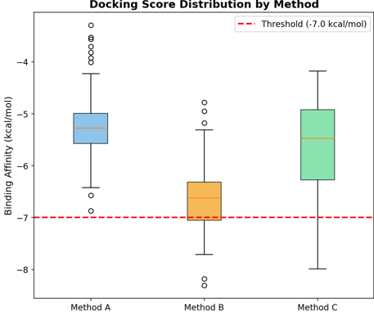
Result 2 – Does docking result improved?
Method A: worst docking result
Method B: best docking result
Method C: second best docking result
Not only motif, but also scaffold affect to the docking result
7 / 12

Slide 8
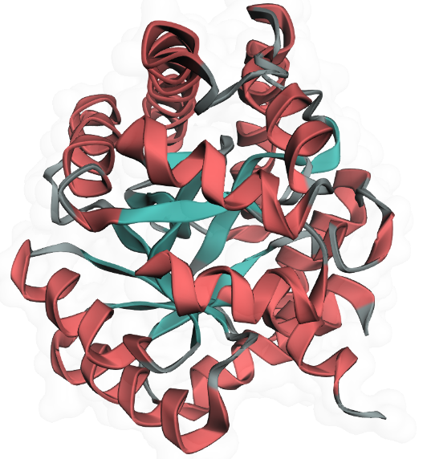
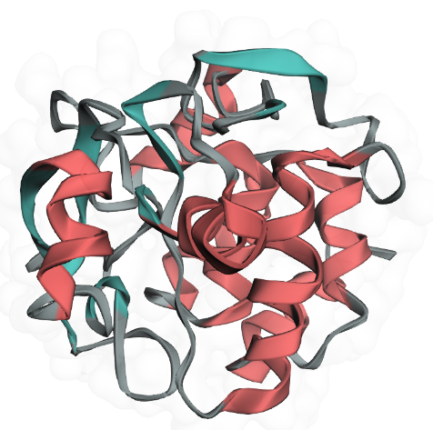
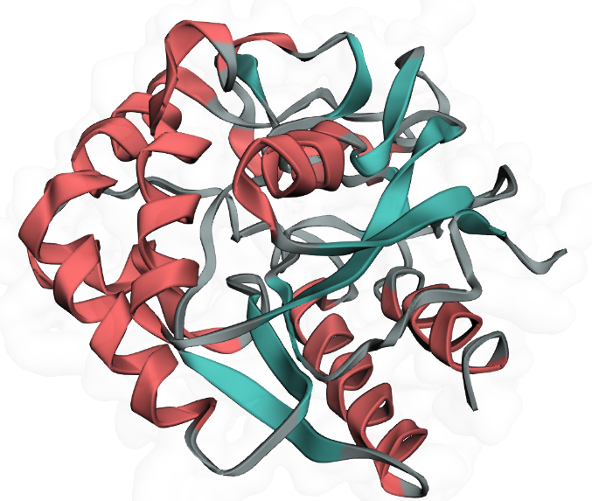
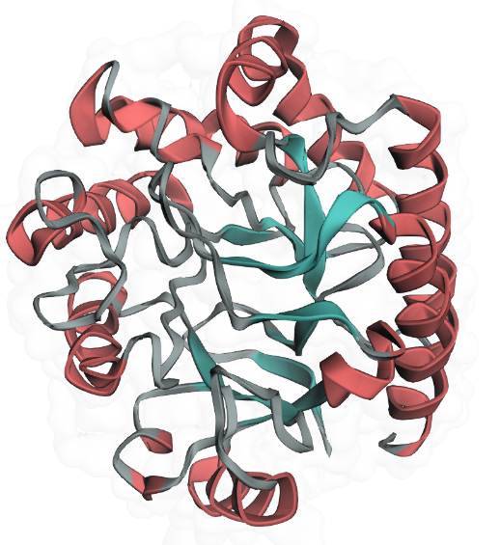
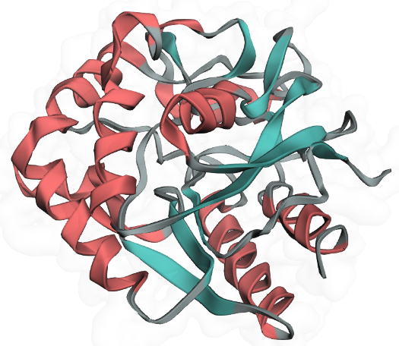
Result 3: what is the sample for wet-lab test?
Structure data
Structural stability + docking ability
Phamaceutical screening
Selectiveness screening
MethodC_66
MethodB_21
Comparison
Result
MethodB_24
MethodB_19
MethodB_33
Total: 15 survived
14 from method B, 1 from method C
Best 5 from the list
8 / 12

Slide 9
Conclusion
Using method B (motif from Genzyme, stability from RFdiffusion3) works better than original version of those (in docking (best), stability (maintain certain criteria))
pLDDT couldn’t be the all-round index for measuring protein quality
For check the result is real, wet-lab is essential in in-silico designation process
9 / 12

Slide 10
Other interesting points?
Is any index can represent the completeness of protein (enzyme) as supertool?
Can it be applied to the complete De novo designed molecules?
Is any tools for enzyme releasing the product?
Calculating structure conformation after the reaction
Preparing the space for product to leaving the pocket
Intending steric hinderance/chemical repel after reaction
10 / 12

Slide 11
Reference
Albert, B. A., Yang, Y., Shao, X. M., Singh, D., Smyth, K. A., Sivak, J., Karchin, R., & Karchin, R. (2023). Deep neural networks predict class I major histocompatibility complex epitope presentation and transfer learn neoepitope immunogenicity. *Nature Machine Intelligence*, *5*(8), 861–872. https://doi.org/10.1038/s42256-023-00694-6
Butcher, J., Krishna, R., et al. (2025). De novo design of all-atom biomolecular interactions with RFdiffusion3. *bioRxiv*. https://doi.org/10.1101/2025.09.18.676967
Chen, V. B., Arendall, W. B., III, Headd, J. J., Keedy, D. A., Immormino, R. M., Kapral, G. J., Murray, L. W., Richardson, J. S., & Richardson, D. C. (2010). MolProbity: All-atom structure validation for macromolecular crystallography. *Acta Crystallographica Section D: Biological Crystallography*, *66*(1), 12–21. https://doi.org/10.1107/S0907444909042073
Dauparas, J., Lee, G. R., Pecoraro, R., An, L., Anishchenko, I., Glasscock, C., & Baker, D. (2023). Atomic context-conditioned protein sequence design using LigandMPNN. *bioRxiv*. https://doi.org/10.1101/2023.12.22.573103
Hayes, T., Rao, R., Akin, H., Sofroniew, N. J., Oktay, D., Lin, Z., Verkuil, R., Tran, V. Q., Deaton, J., Wiber, M., Anand, N., Puhringer, M., Patra, A., Liu, J., Canny, J., & Rives, A. (2024). Simulating 500 million years of evolution with a language model. *bioRxiv*. https://doi.org/10.1101/2024.07.01.600583
Lieberman, R. L., Wustman, B. A., Huertas, P., Powe, A. C., Pine, C. W., Khanna, R., Schlossmacher, M. G., Bhattacharjee, A., Bhattacharjee, S., Bhattacharjee, S., Bhattacharjee, S., & Bhattacharjee, S. (2007). Structure of acid β-glucosidase with pharmacological chaperone provides insight into Gaucher disease. *Nature Chemical Biology*, *3*(2), 101–107. https://doi.org/10.1038/nchembio850
Lin, Z., Akin, H., Rao, R., Hie, B., Zhu, Z., Lu, W., Smetanin, N., Verkuil, R., Kabeli, O., Shmueli, Y., dos Santos Costa, A., Fazel-Zarandi, M., Sercu, T., Candido, S., & Rives, A. (2023). Evolutionary-scale prediction of atomic-level protein structure with a language model. *Science*, *379*(6637), 1123–1130. https://doi.org/10.1126/science.ade2574
Liou, B., Haffey, W. D., Greis, K. D., & Grabowski, G. A. (2014, October 24). The limp-2/scarb2 binding motif on acid β-glucosidase: Basic and applied implications for Gaucher disease and associated neurodegenerative diseases. The Journal of biological chemistry. https://pmc.ncbi.nlm.nih.gov/articles/PMC4208013/
Lovell, S. C., Davis, I. W., Arendall, W. B., III, de Bakker, P. I. W., Word, J. M., Prisant, M. G., Richardson, J. S., & Richardson, D. C. (2003). Structure validation by Cα geometry: φ,ψ and Cβ deviation. *Proteins: Structure, Function, and Bioinformatics*, *50*(3), 437–450. https://doi.org/10.1002/prot.10286
Pudžiuvelytė, I., Olechnovič, K., Godber, C., Olechnovič, K., & Venclovas, Č. (2024). TemStaPro: Protein thermostability prediction using sequence representations from protein language models. *Bioinformatics*, *40*(4), btae157. https://doi.org/10.1093/bioinformatics/btae157
Ramachandran, G. N., Ramakrishnan, C., & Sasisekharan, V. (1963). Stereochemistry of polypeptide chain configurations. *Journal of Molecular Biology*, *7*(1), 95–99. https://doi.org/10.1016/S0022-2836(63)80023-6
Rathore, A. S., Arora, A., Srivastava, S., & Raghava, G. P. S. (2024). ToxinPred 3.0: An improved method for predicting the toxicity of peptides. *Computers in Biology and Medicine*, *179*, 108926. https://doi.org/10.1016/j.compbiomed.2024.108926
Trott, O., & Olson, A. J. (2010). AutoDock Vina: Improving the speed and accuracy of docking with a new scoring function, efficient optimization, and multithreading. *Journal of Computational Chemistry*, *31*(2), 455–461. https://doi.org/10.1002/jcc.21334
11 / 12

Slide 12


Thank you for your listening
Feel free to ask questions!
Presenter: Kwon, Jihun
Contact: Jihun.kwon@ghent.ac.kr
12 / 12

